Slide 1
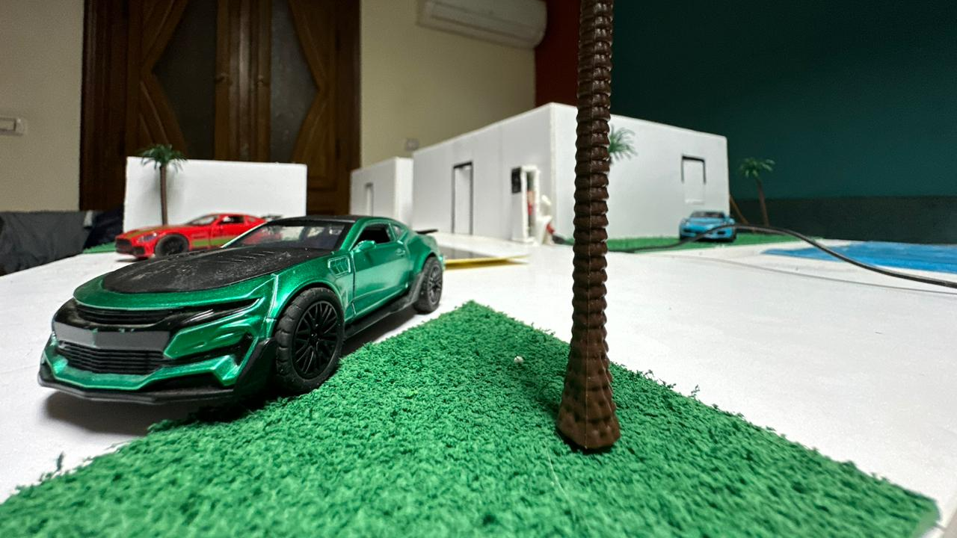
Graduation Project “Smart City Automation System”

